Slide 1
Crazy Cow

Slide 2
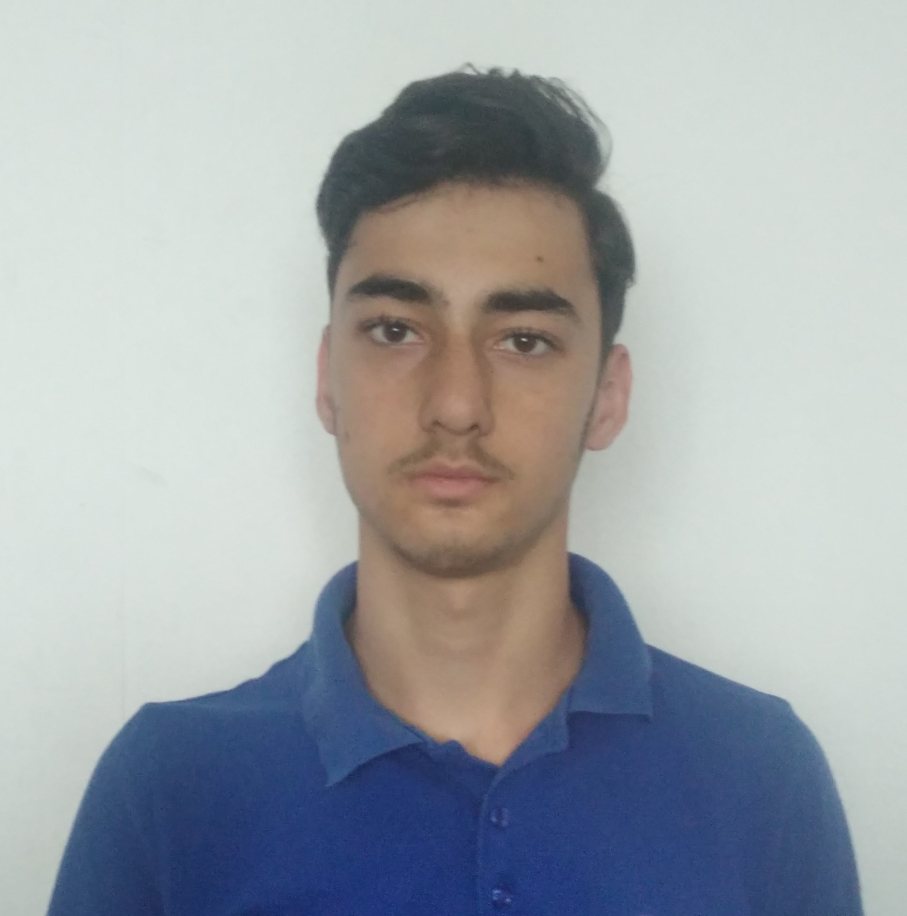
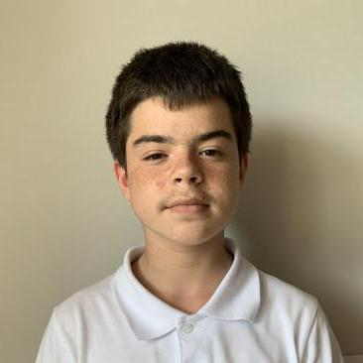
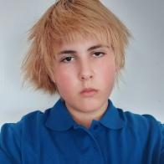
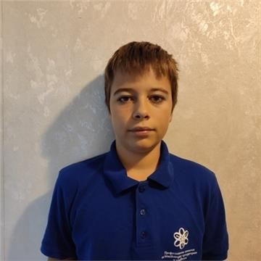
OUR TEAM
Zhivko Spasov 10g
Scrum trainer
Ivan Dadakov 10a
Back-end
Samuil Shkvarla 10a Back-end
Yoan Todorov 10v
QA Engineer

Slide 3
OUR IDEA

Slide 4
STAGES OF WORK
01
02
03
04
IDEA DISCUSSION
EARLY STAGES
LATE STAGES
PRESENTING

Slide 5








USED PROGRAMS

Slide 6
NOW LET’S JUMP TO OUR REPO

